Slide 1

WIRELESS SENSOR NETWORKS
Done by:- Guided by:-
ADITYA SIVA PADALA Prof.Ms.VEENA ANAND
14115003

Slide 2
Agenda
Introduction to WSN
Introduction to clustering
Clustering and its techniques
Energy usage models
OOCN and its phases
Conclusion

Slide 3
Wireless Sensor Network
A wireless sensor network (WSN) consists of hundreds or even thousands of tiny and inexpensive electronic devices called sensor nodes.
Sensor Node:- A sensor node usually includes different modules like communication, sensing, and processing module.
The sensing module is in charge of measuring a parameter such as pressure, temperature, motion, etc.
The measured value is transmitted to a central point called sink using the communication module however, some initial processing over the measured value might be required before transmission.

Slide 4
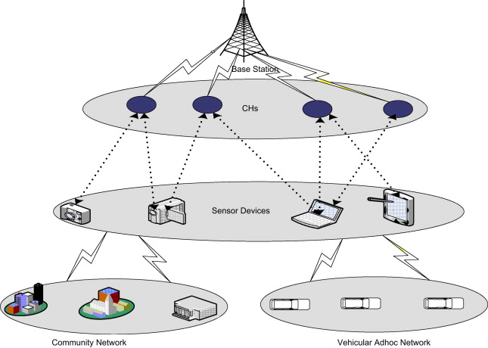
Generalized view of WSN

Slide 5
Why the need of energy efficient protocol for WSN’S
Like other types of wireless devices, the sensor nodes suffer from many limitations like unreliable communication links, limited frequency bands and security issues.
One more challenge for sensor nodes is that since the sensor nodes should be inexpensive, small and light, the memory capacity, CPU power and especially battery size is extremely limited.
Also, in many scenarios like environment monitoring and military applications, the sensor nodes are not accessible for a long time. In such a situation, the battery replacement (if not impossible), is very difficult.
Hence, designing an energy efficient communication protocol for WSNs is inevitable.

Slide 6
Clustering
Clustering is the task of assigning a set of objects to groups (also called classes or categories) so that the objects in the same cluster are more similar (according to a predefined property) to each other than to those in other clusters.
In networking, the network area is divided into small areas, called clusters.
In each cluster, a node is selected as the cluster head (CH) and is responsible for intra-cluster and inter-cluster communications.
In communication protocols based on clustering concept, time is discrete and thus divided into time slots in which any non-cluster head node (non-CH) sends gathered data to its cluster head.

Slide 7
CLUSTERING TECHNIQUES
Since cluster heads are responsible for inter- and intra-cluster communications, they usually consume more energy compared to the non-cluster head nodes. Hence many protocols have been proposed to balance the energy consumption in the network.
Some of well-known clustering methods which try to balance the network energy consumption by periodically rotate cluster head role among all nodes are LEACH and HEED.

Slide 8
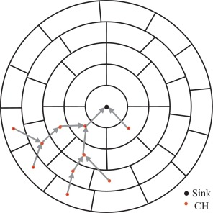
Clustering and communication between cluster heads

Slide 9
Low-Energy Adaptive Clustering Hierarchy (LEACH):-
LEACH is a self organizing, adaptive clustering protocol which uses equalized energy load distribution among the sensor networks in the WSN.
In LEACH protocol, the sensor networks organize themselves into local clusters, with one node acting as the leader and known as cluster head (CH) and rest of the nodes act as ordinary nodes.
The operation of LEACH is divided into rounds and each round is divided into two phases namely as: setup and steady-state phase.
Set-Up phase:- A phase where cluster heads are chosen.
Steady phase:-The phase where cluster head is maintained and data is transmitted between nodes.

Slide 10
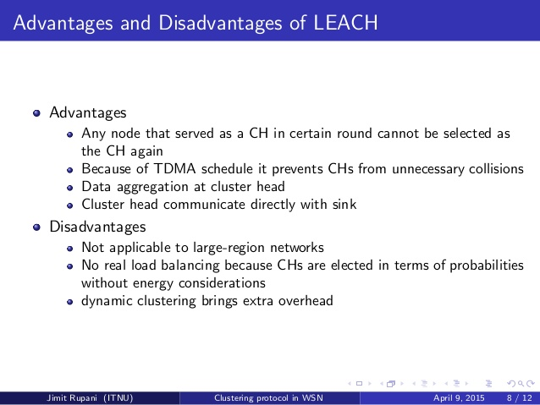
ADVANTAGES AND DISADVANTAGES OF LEACH

Slide 11
ENERGY USAGE MODELS
Network model
The network is considered as a circular area in which, the sink is placed in the center and nodes are evenly distributed around it.
The communication protocol starts with setup phase. In this phase, each node participates in a self-organizing process to identify its role (either CH or non-CH) in the next phase and receives its time schedule.
Next phase is data gathering phase, in data gathering phase, network operation is divided into many time slots and each time slot includes time frames.
In each time slot, non-cluster head nodes act only in their scheduled time frame and are inactive in the rest of it to save energy.

Slide 12
Contd..
ENERGY MODEL
A sensor node is always in either the active or the passive mode.
An active node is a node which participates in the network’s operation or sensing the environment or sending data to the other nodes or sink.
A passive node is a node which is temporarily abandoned sensing or participating in running a protocol or has run out of energy and has died.
The energy consumption of an active node is comprised of three parts (the energy consumption of sending (ETx), receiving (ERx), and data processing (EDP).

Slide 13
Contd..
ETx(l) = l × Eelec + Eamp × dY
ERx(l) = l × Eelec
EDA(l) = l × Ecpu
where l is packet length (bit), d is transmission distance (m), Eelec (nJ/bit) is the electronic energy to run the radio circuitry, Eamp (nJ/bit/m2) is the amplifier energy needed by the transmitter for an acceptable Signal to Noise Ratio (SNR) at the receiver demodulator and γ is the path loss exponent which is 2 in the free space environment. EDA (nJ/bit) is the energy dissipation for data aggregation and ECPU (nJ/bit) is the energy dissipation for processing per bit.

Slide 14
Optimal Clustering in Circular Networks (OOCN)
As dealt previously, clustering, data aggregation and, multi-hop communication are three major techniques to reduce network energy consumption.
On the other hand, load balancing among all nodes helps to avoid premature death of nodes.
Hence a optimal scalable clustering method which provides fair traffic forwarding using optimal sized clusters and optimal multi hop packet relaying is proposed called Optimal Clustering in Circular Networks (OCCN).
OCCN is a distributed sub-optimal clustering algorithm which benefits from the optimal parameters.

Slide 15
CONTD..
To apply the proposed clustering method, a manual node placement procedure has to be done. In case the sensor nodes should be distributed randomly, their location information is needed at the sink.
Data gathering phase in distributed OCCN is similar to the optimal version, though the setup phase includes two different steps: reservation phase and upper cluster head selection phase.

Slide 16
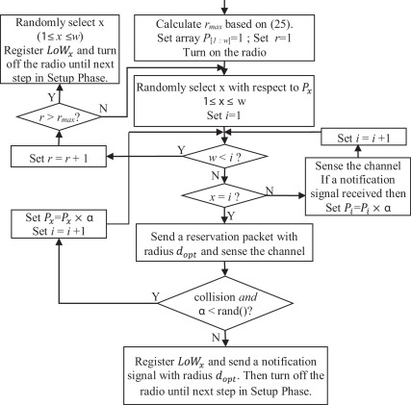
RESEVATION PROCESS IN OOCN

Slide 17
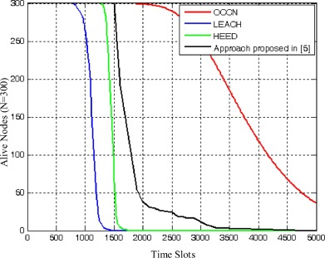
WSN parameters averaged with 20000 different random topologies

Slide 18
CONCLUSION
Tiny wireless sensor nodes suffer from different constraints such as small battery capacity.
Hence a multi-hop communication protocol is proposed which benefits from optimal parameters.
Moreover, a distributed reservation based cluster head selection is proposed to reduce the energy consumption due to a large number of message passing during iterative cluster head selection.
Compared to the existing method, the proposed OCCN improves the network lifetime considerably.
Apart from network lifetime, the energy reduction trend is almost linearly, at least until 50% of the nodes are alive.
Additionally, OCCN perfectly postpones the time that the first node is dead when the network is divided into the optimal number of clusters.

Slide 19
THANK YOU

